Slide 1
跟着Kevin学英语(13)
Secrets

Slide 2
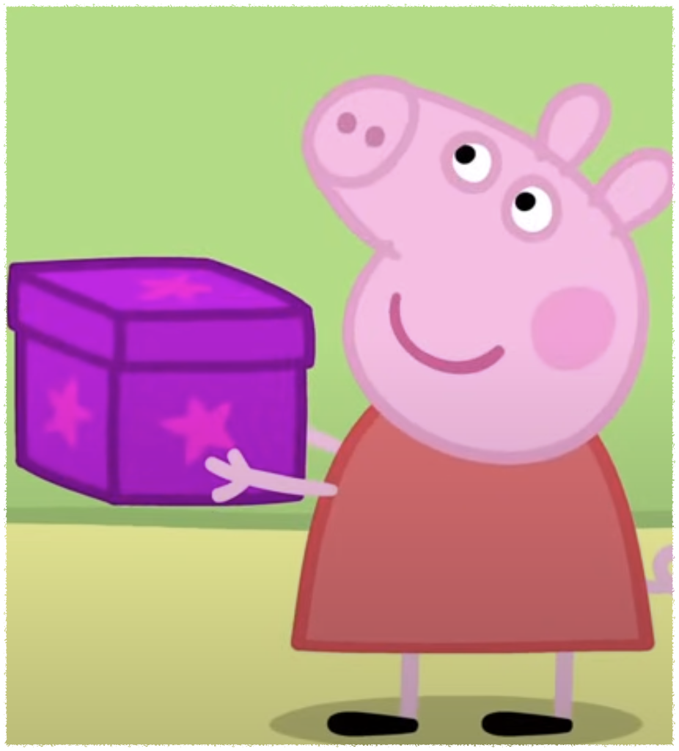
S s
Secret
Notes:
It’s a secret

Slide 3
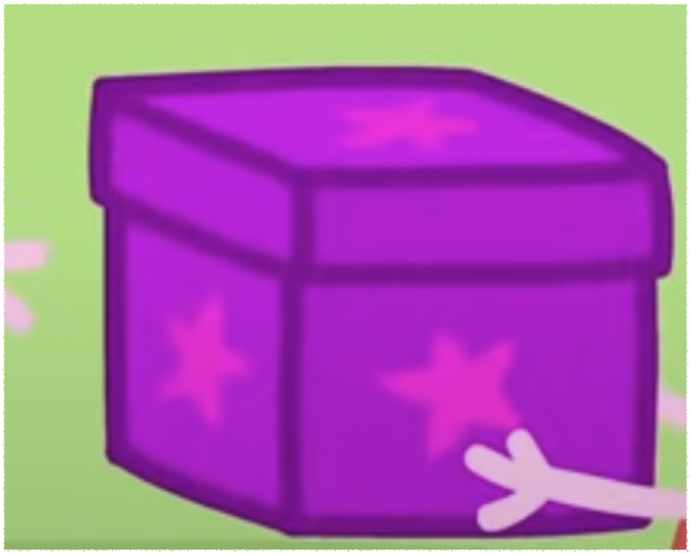
B b
Box
Notes:
This is my secret box

Slide 4
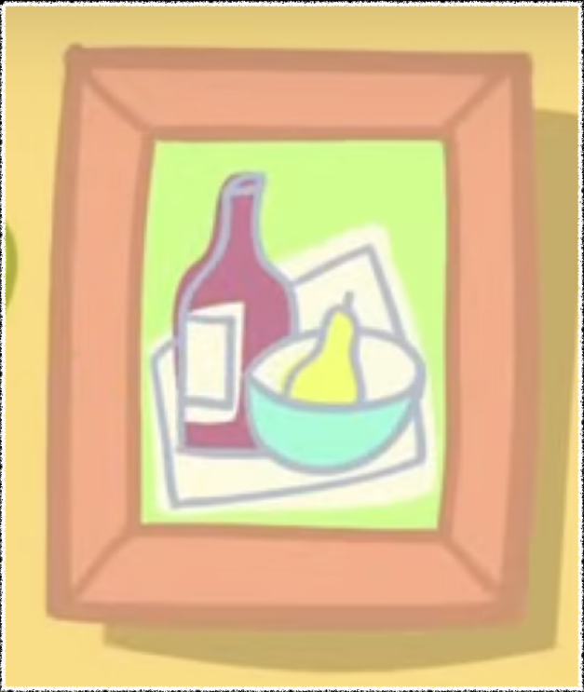
P p
Picture
Notes:
Dad is cleaning the picture

Slide 5
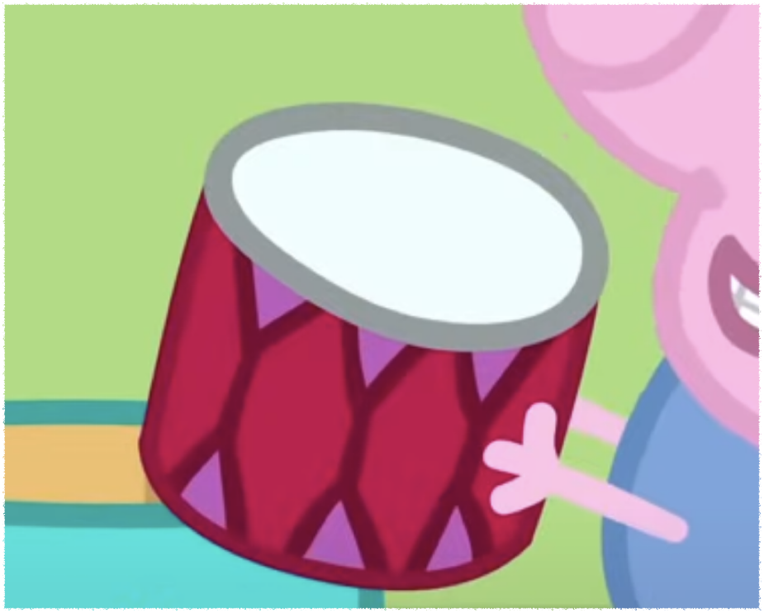
D d
Drum
Donut
Notes:
There is a drum

Slide 6
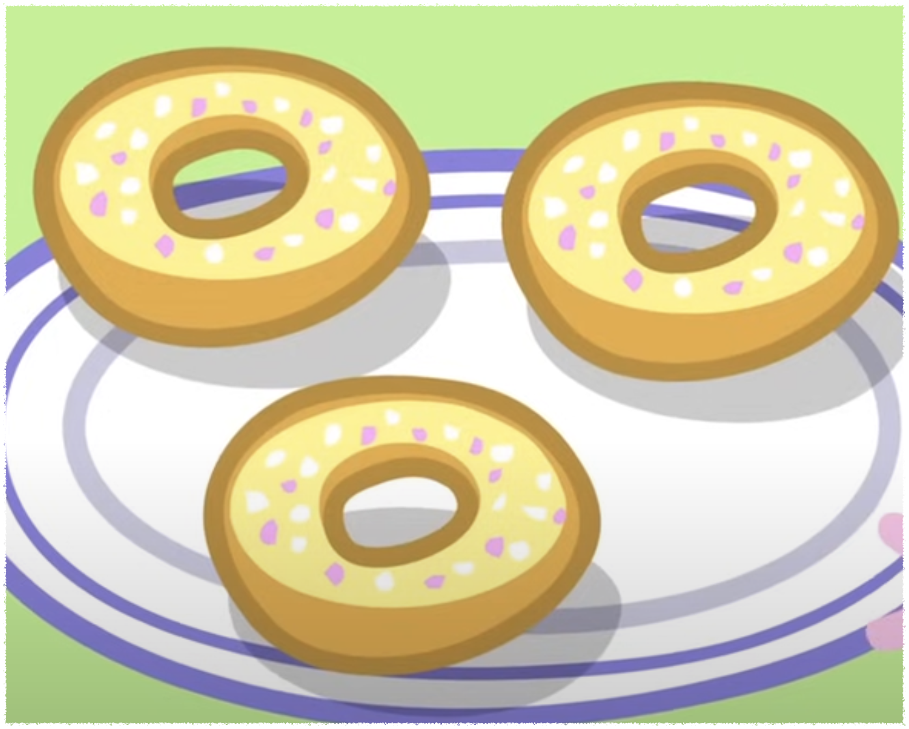
D d
Drum
Donut
Notes:
We all like donuts

Slide 7
This is just for you
You can try to guess
It's too difficulty
Me too

